Slide 1
ABOUT THE DATASET
E-retail factors for customer activation and retention: A case study from Indian e-commerce customers
Customer satisfaction has emerged as one of the most important factors that guarantee the success of online store Customer satisfaction consists of a customer's perceived quality, value and expectations of your company and what you offer.Not only is it a leading indicator used to measure customer loyalty and retention, it enables businesses to identify unhappy customers, reduce customer losses and negative word of mouth whilst increasing revenue.Five major factors that contributed to the success of an e-commerce store have been identified as: service quality, system quality, information quality, trust and net benefit. The research furthermore investigated the factors that influence the online customers repeat purchase intention. The combination of both utilitarian value and hedonistic values are needed to affect the repeat purchase intention (loyalty) positively. The data is collected from the Indian online shoppers. Results indicate the e-retail success factors, which are very much critical for customer satisfaction.

Slide 2
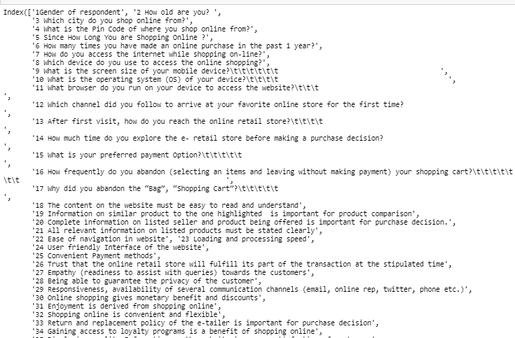
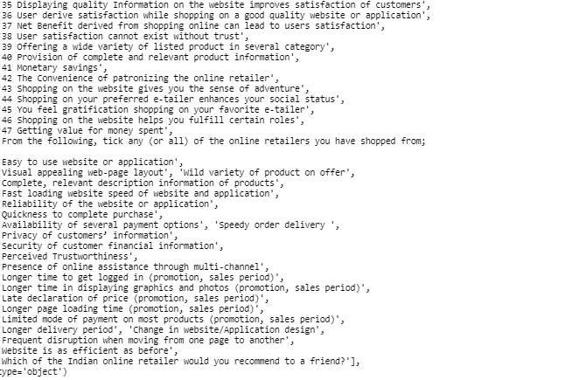
ABOUT THE COLUMNS PRESENT IN THE DATASET

Slide 3
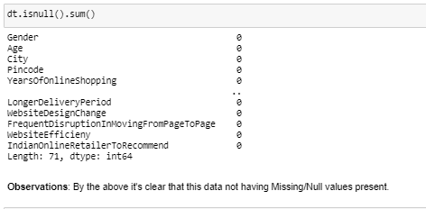
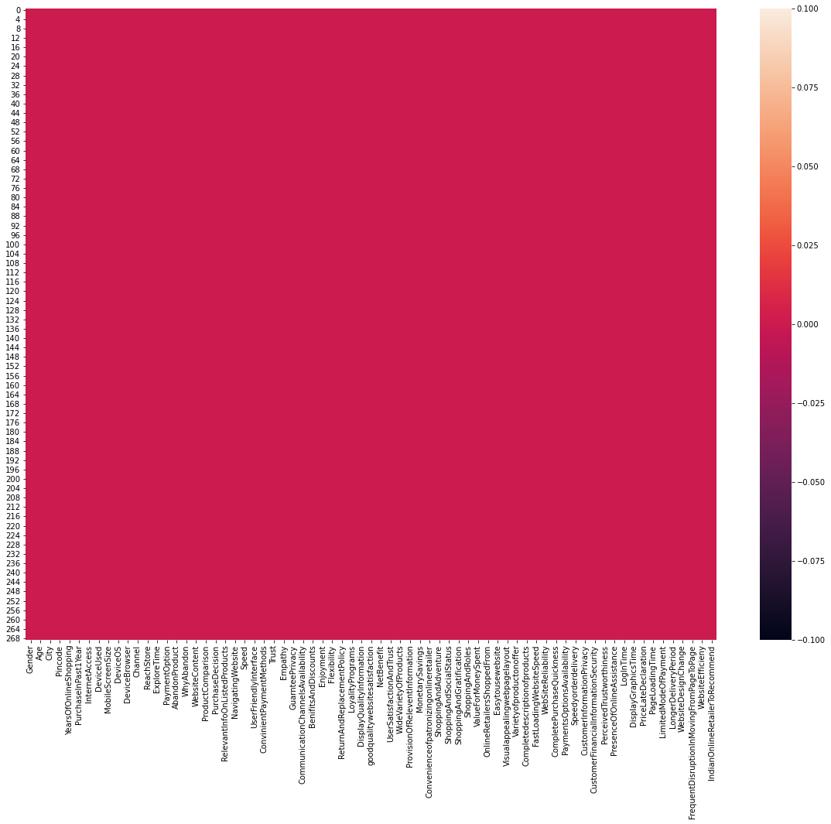
CHECKING FOR THE NULL VALUES

Slide 4
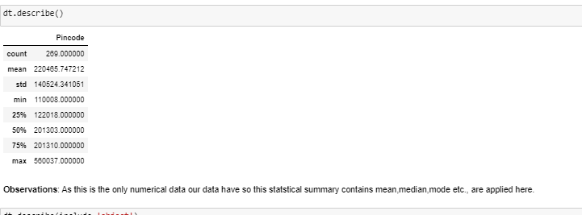
ABOUT THE STATISTICAL SUMMARY

Slide 5
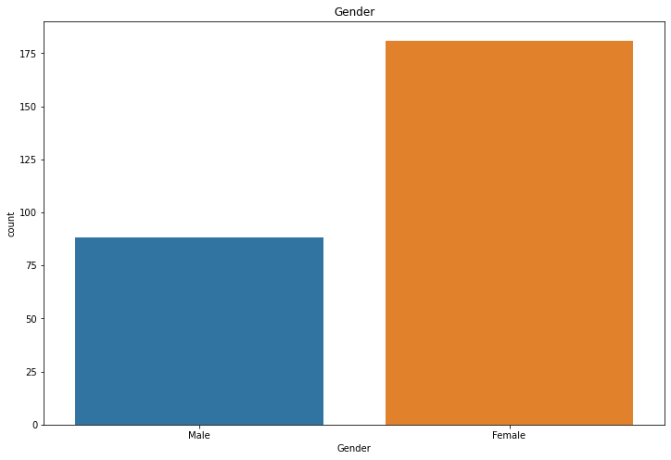
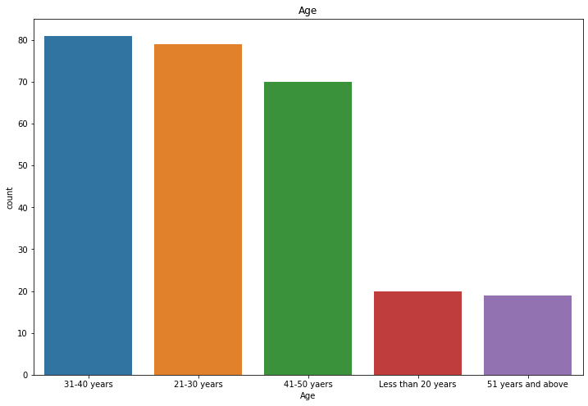
PRESENTING THE VISUALIZATION OF THE DATA
THERE WERE MORE FEMALES THAN THAT OF MALES
MOSTLY ACTIVE USERS ARE OF AGE BETWEEN 31-40 YEARS

Slide 6
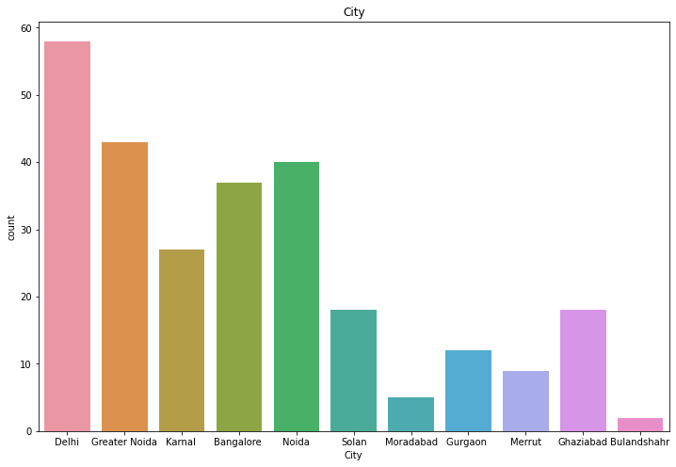
we can see a very large no.of people shopping from Delhi city i.e in between 50 to 60.
Similarly people from Greater Noida shopping in between 40 to 50.
Similarly people from Kamal shopping in between 20 to 30.
Similarly people from Bangalore shopping in between 30 to 40.
Similarly people from Noida shopping almost 40.
Similarly people from Solan city shopping in between 10 to 20.
Similarly people from Moradabad shopping in between 0 to 10.
Similarly people from Gurgaon shopping in between 10 to 20.
Similarly people from Meerut shopping almost 10.
Similarly people from Ghaziabad shopping in between 10 to 20.

Slide 7
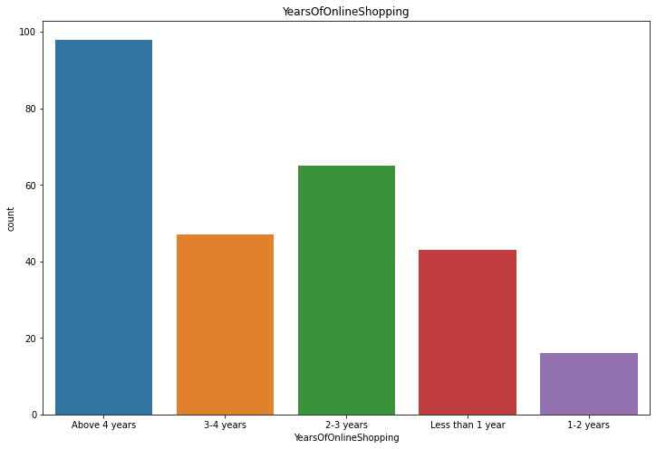
Here some E-commerce site having an experience of Above 4 years are in between 80-100.
Some other having 3-4 years in between 40-60.
Other having 2-3 years are in between 60-80.
Less than 1 year are in 40.
In between 1-2 years are in 0-20 respectively.

Slide 8
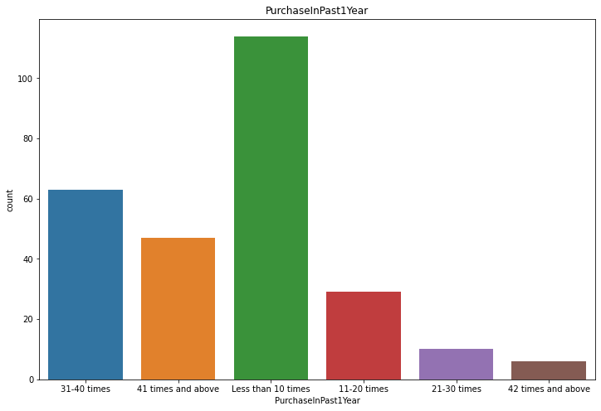
The people in blue code above 60 in numbers are purchased the item 31-40 times in past 1 year.
The people in orange code in between 40-60 in numbers are purchased the item 41 times in past 1 year.
The people in green code above 100 in numbers are purchased the item less than 10 times in past 1 year.
The people in red code in between 20-40 in numbers are purchased the item 11-20 times in past 1 year.
The people in violet code in between 0-20 in numbers are purchased the item 21-30 times in past 1 year.
The people in brown code in between 0-20 in numbers are purchased the item 42 times in past 1 year.

Slide 9
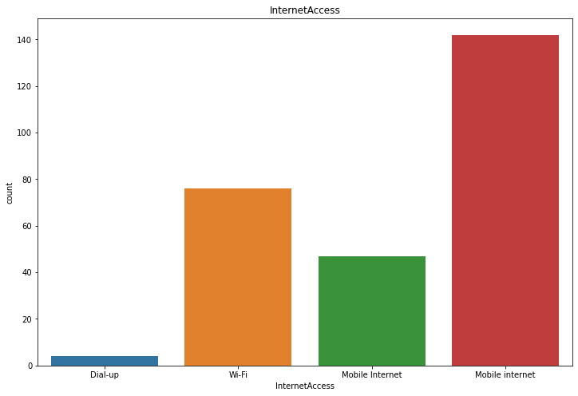
Its clear that most of people were using/Depends up on **Mobile Internet** rather than **Wifi or Dial-up** for online shopping.

Slide 10
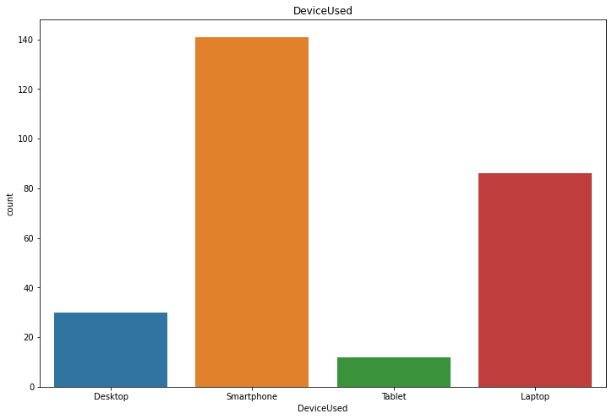
**Samrtphones**are more popular devices used by public and then next is **Laptop** then **Desktop** & **Tablet**.

Slide 11
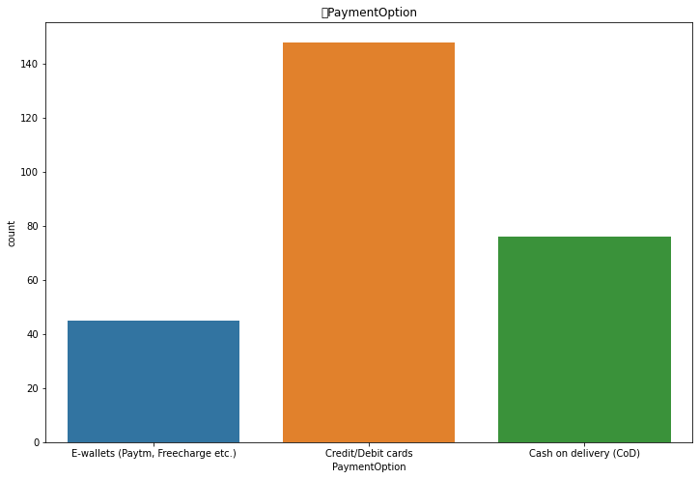
Public used Credit/Debit Cards while shopping. Then by Cash on Deleivey(COD) and then E-wallets

Slide 12
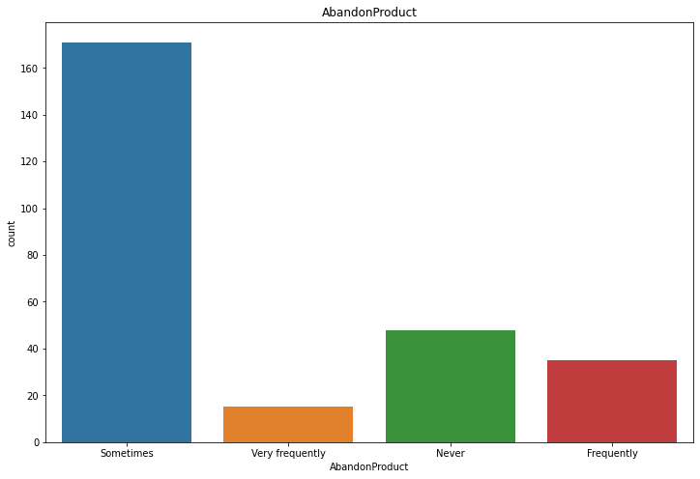
Sometimes most of the people do abandoned the items in list while shopping online.

Slide 13
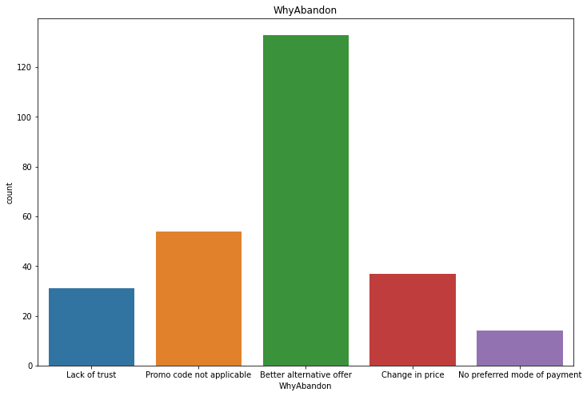
Most people abandoned the items of their list because they have " Better_alternative_offers" followed by "Promo code not applicable".

Slide 14
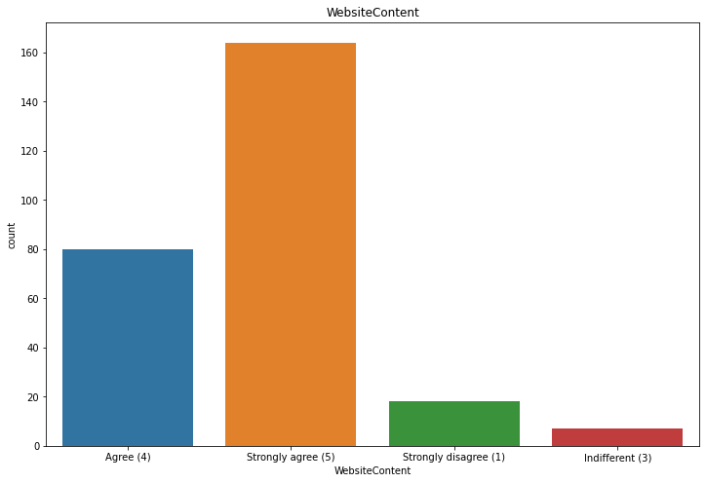
**Observations**:
Mostly people strongly agree that "Website Content" is very much important.
Very less people disagree with "Website Content" is very much important.

Slide 15
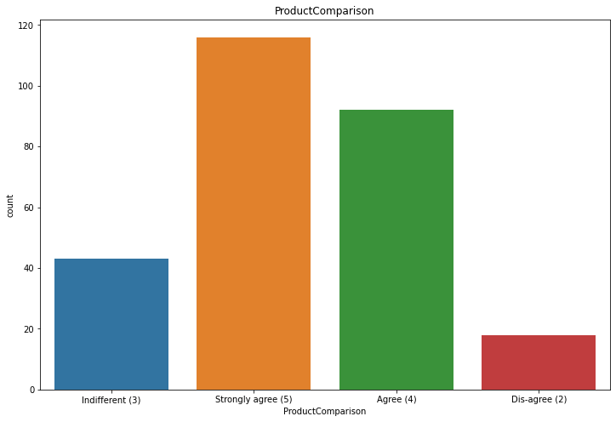
Most people thinks Product comparison is very much need. For getting the better product.

Slide 16
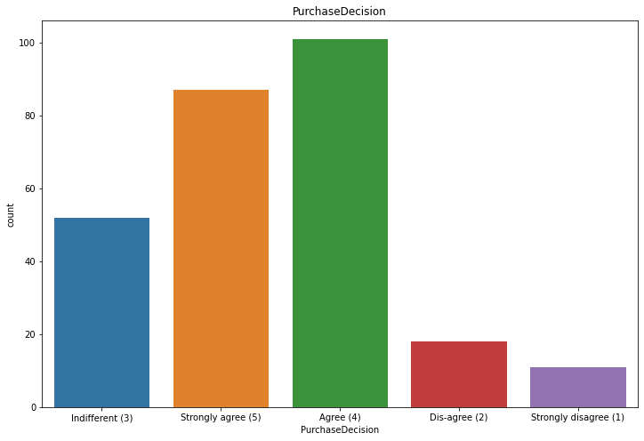
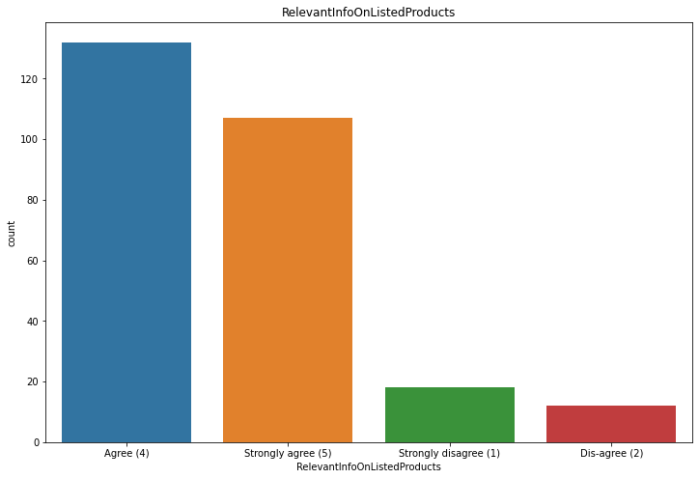
Most people will show intrest on the information about the product if they want to buy. So, there are above 120 in number of people who are agree for this.
Most of people will show intrest in decission whether to purchase the product or not in maximum range.

Slide 17
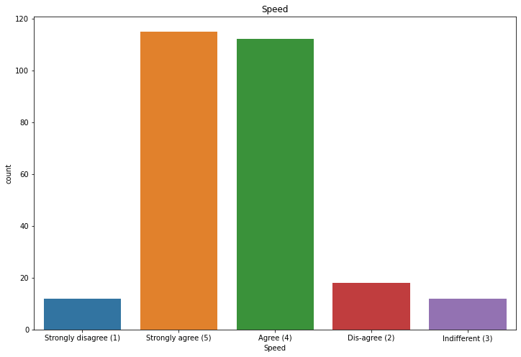
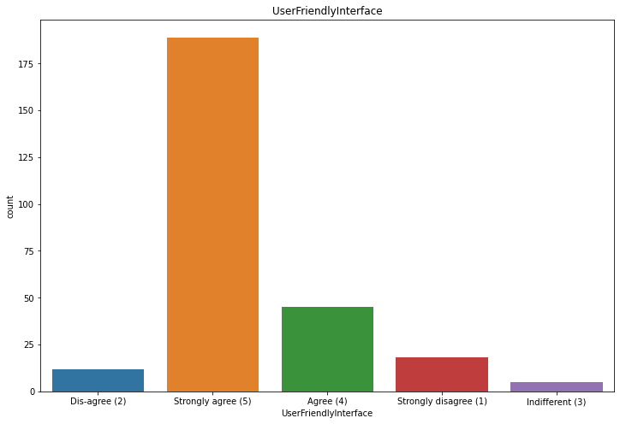
Most people will agree network should be speed enough.

Slide 18
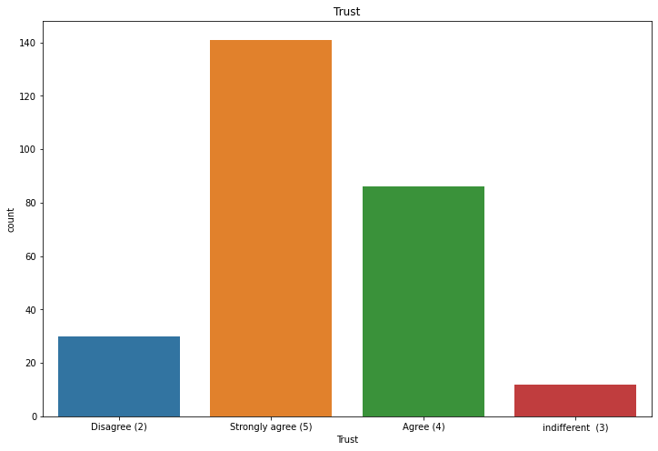
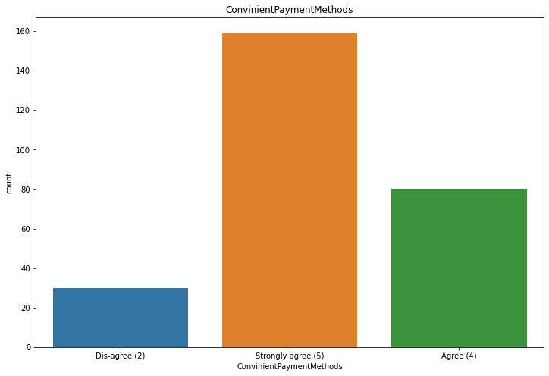
Trust is the most important thing in business it plays very crucial role. So in this Obviously all people will strongly agree while purchasing an item.
Most people will stongly agree for purchasing the items in simple way.

Slide 19
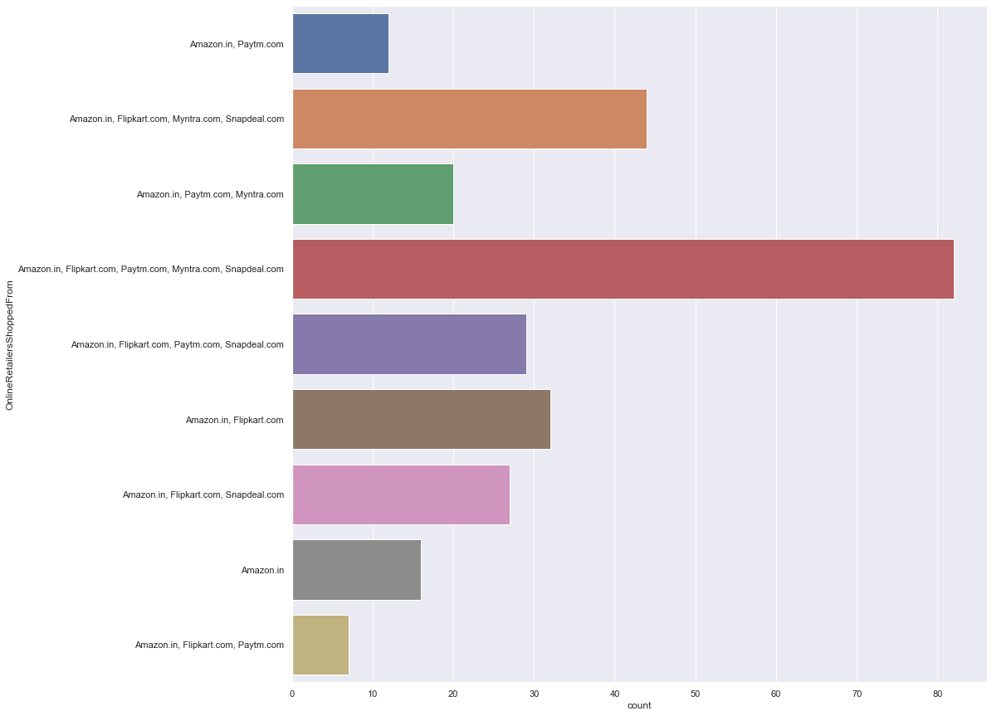
We can see that mostly people are recommending "Amazon.com" & "Flipkart.com" to others.
Least were recommended website is "Paytm" & "Snapdeal".

Slide 20
OBSERVATION / CONCLUSION FROM THE DATA SET
From the data we got to know that many of the females are more actives than males so policies and material can be added by giving more preference to females
There are many weak points that came into notice so companies can work over it
There is a huge amount of population which are not much active in E-commerce sector or shopping by making policies as per their easiness , customer reach can be increase
Many companies usually took a lot of time in delivering the item and many miss the payment options so they can work over it , that will also increase their customer base
From the data we came to know that all companies are not perfect in providing the services, even the good and big giants companies like Amazon and Flipkart suffers a lot in many of the domain , so by analysing this small competitors can make then better and also big giants can also in their services
The data can also help in increasing the customer base and also can help in increasing of the Profits of the organization
Data help the companies by clearly stating them the issues and problems of the customers and about the companies where they lack

